Slide 1
Sliding window technique

Slide 2
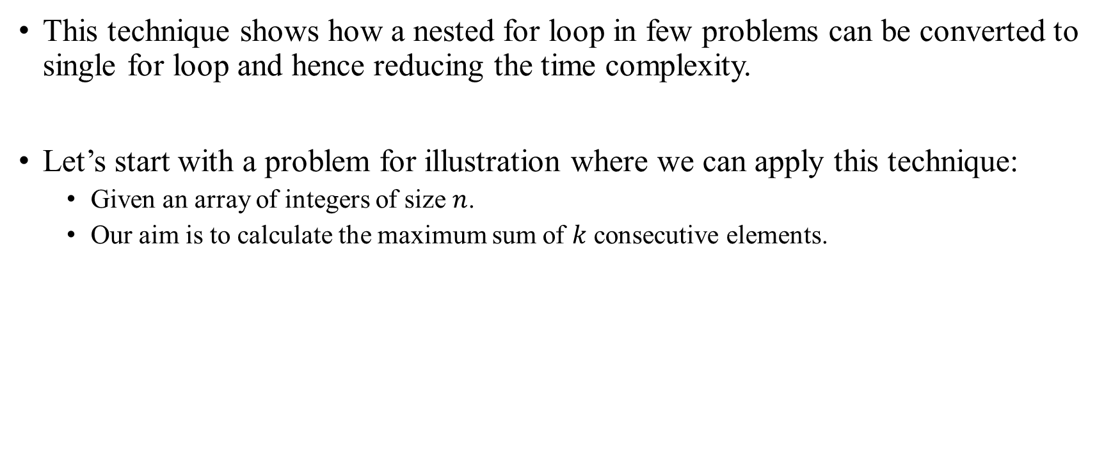
Sliding window technique
This technique shows how a nested for loop in few problems can be converted to single for loop and hence reducing the time complexity.
Let’s start with a problem for illustration where we can apply this technique։
Given an array of integers of size $n$.
Our aim is to calculate the maximum sum of $k$ consecutive elements.

Slide 3
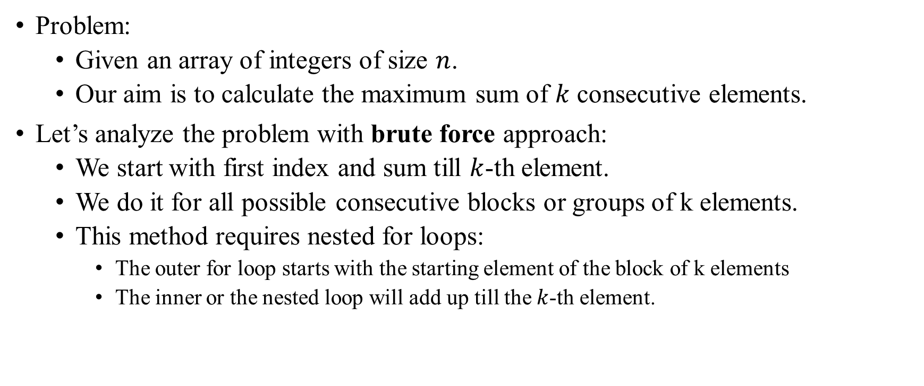
Sliding window technique Problem solution
Problem:
Given an array of integers of size $n$.
Our aim is to calculate the maximum sum of $k$ consecutive elements.
Let’s analyze the problem with brute force approach:
We start with first index and sum till $k$-th element.
We do it for all possible consecutive blocks or groups of k elements.
This method requires nested for loops:
The outer for loop starts with the starting element of the block of k elements
The inner or the nested loop will add up till the $k$-th element.

Slide 4
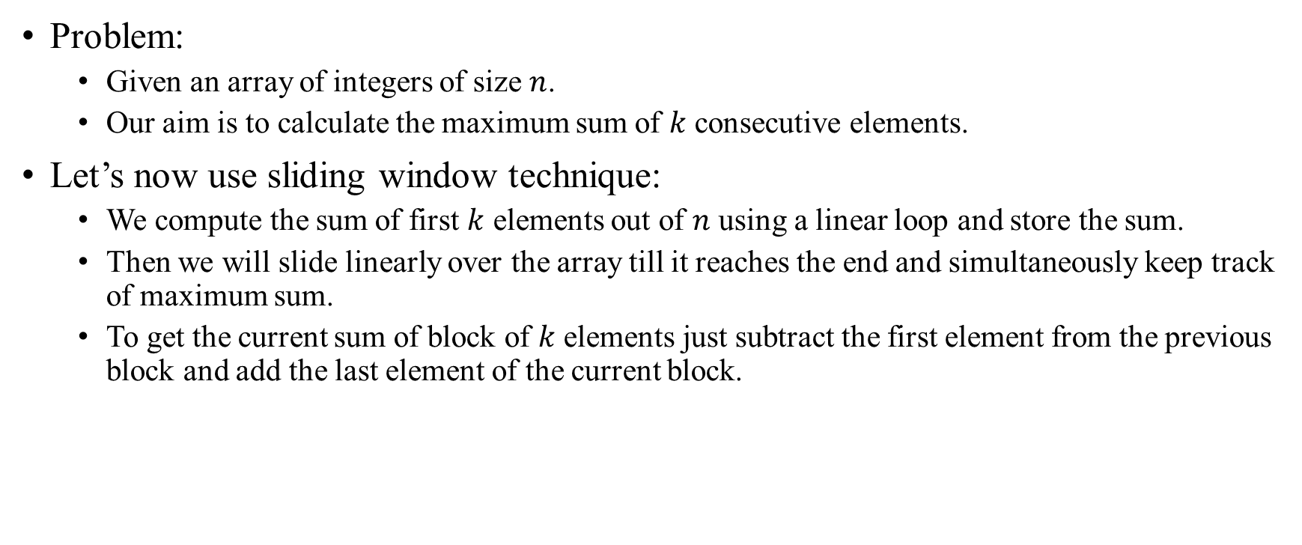
Sliding window technique Problem solution
Problem:
Given an array of integers of size $n$.
Our aim is to calculate the maximum sum of $k$ consecutive elements.
Let’s now use sliding window technique:
We compute the sum of first $k$ elements out of $n$ using a linear loop and store the sum.
Then we will slide linearly over the array till it reaches the end and simultaneously keep track of maximum sum.
To get the current sum of block of $k$ elements just subtract the first element from the previous block and add the last element of the current block.

Slide 5

Sliding window technique Problem visualization
Problem:
Given an array of integers of size $n$.
Our aim is to calculate the maximum sum of $k$ consecutive elements.
Let’s suppose array size is 10 and $k$ is 3
10 | 8 | 6 | 13 | 11 | 15 | 1 | 50 | 2 | 10

Slide 6
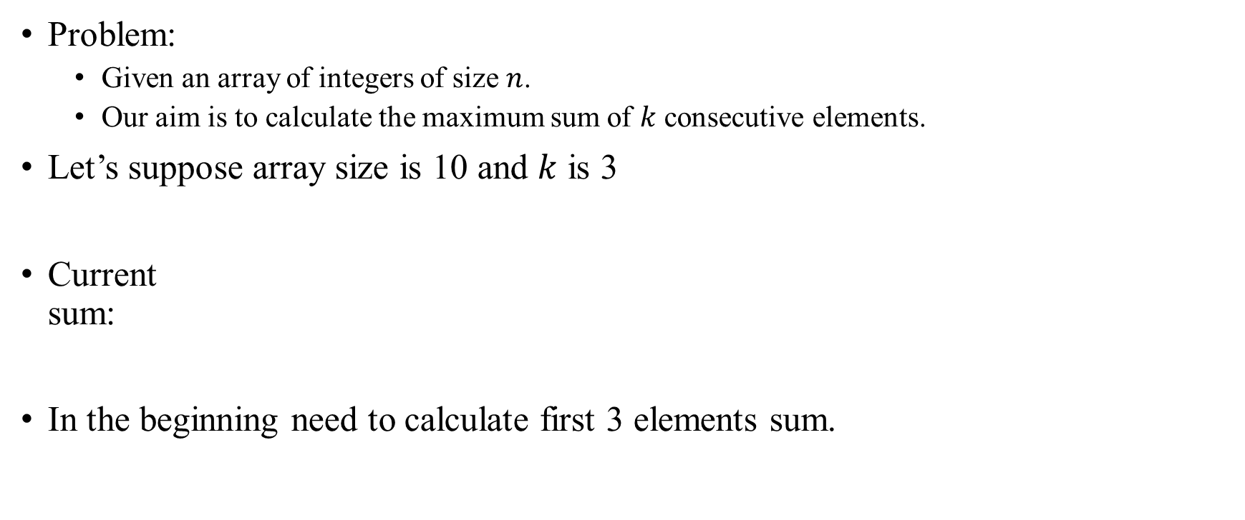
Sliding window technique Problem visualization
Problem:
Given an array of integers of size $n$.
Our aim is to calculate the maximum sum of $k$ consecutive elements.
Let’s suppose array size is 10 and $k$ is 3
Current sum:
In the beginning need to calculate first 3 elements sum.
10 | 8 | 6 | 13 | 11 | 15 | 1 | 50 | 2 | 10

Slide 7
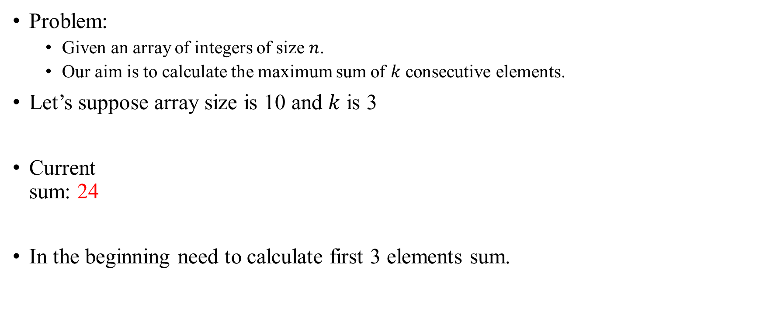
Sliding window technique Problem visualization
Problem:
Given an array of integers of size $n$.
Our aim is to calculate the maximum sum of $k$ consecutive elements.
Let’s suppose array size is 10 and $k$ is 3
Current sum: 24
In the beginning need to calculate first 3 elements sum.
10 | 8 | 6 | 13 | 11 | 15 | 1 | 50 | 2 | 10

Slide 8

Sliding window technique Problem visualization
Problem:
Given an array of integers of size $n$.
Our aim is to calculate the maximum sum of $k$ consecutive elements.
Let’s suppose array size is 10 and $k$ is 3
Best sum: 27
In every next step need to add next element to sum and remove first.
10 | 8 | 6 | 13 | 11 | 15 | 1 | 50 | 2 | 10

Slide 9

Sliding window technique Problem visualization
Problem:
Given an array of integers of size $n$.
Our aim is to calculate the maximum sum of $k$ consecutive elements.
Let’s suppose array size is 10 and $k$ is 3
Best sum: 30
In every next step need to add next element to sum and remove first.
10 | 8 | 6 | 13 | 11 | 15 | 1 | 50 | 2 | 10

Slide 10

Sliding window technique Problem visualization
Problem:
Given an array of integers of size $n$.
Our aim is to calculate the maximum sum of $k$ consecutive elements.
Let’s suppose array size is 10 and $k$ is 3
Best sum: 39
In every next step need to add next element to sum and remove first.
10 | 8 | 6 | 13 | 11 | 15 | 1 | 50 | 2 | 10

Slide 11
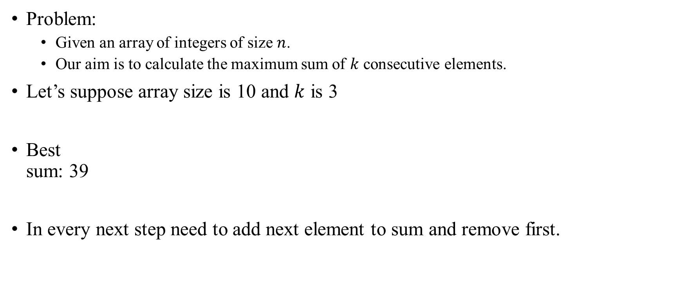
Sliding window technique Problem visualization
Problem:
Given an array of integers of size $n$.
Our aim is to calculate the maximum sum of $k$ consecutive elements.
Let’s suppose array size is 10 and $k$ is 3
Best sum: 39
In every next step need to add next element to sum and remove first.
10 | 8 | 6 | 13 | 11 | 15 | 1 | 50 | 2 | 10

Slide 12

Sliding window technique Problem visualization
Problem:
Given an array of integers of size $n$.
Our aim is to calculate the maximum sum of $k$ consecutive elements.
Let’s suppose array size is 10 and $k$ is 3
Best sum: 66
In every next step need to add next element to sum and remove first.
10 | 8 | 6 | 13 | 11 | 15 | 1 | 50 | 2 | 10

Slide 13
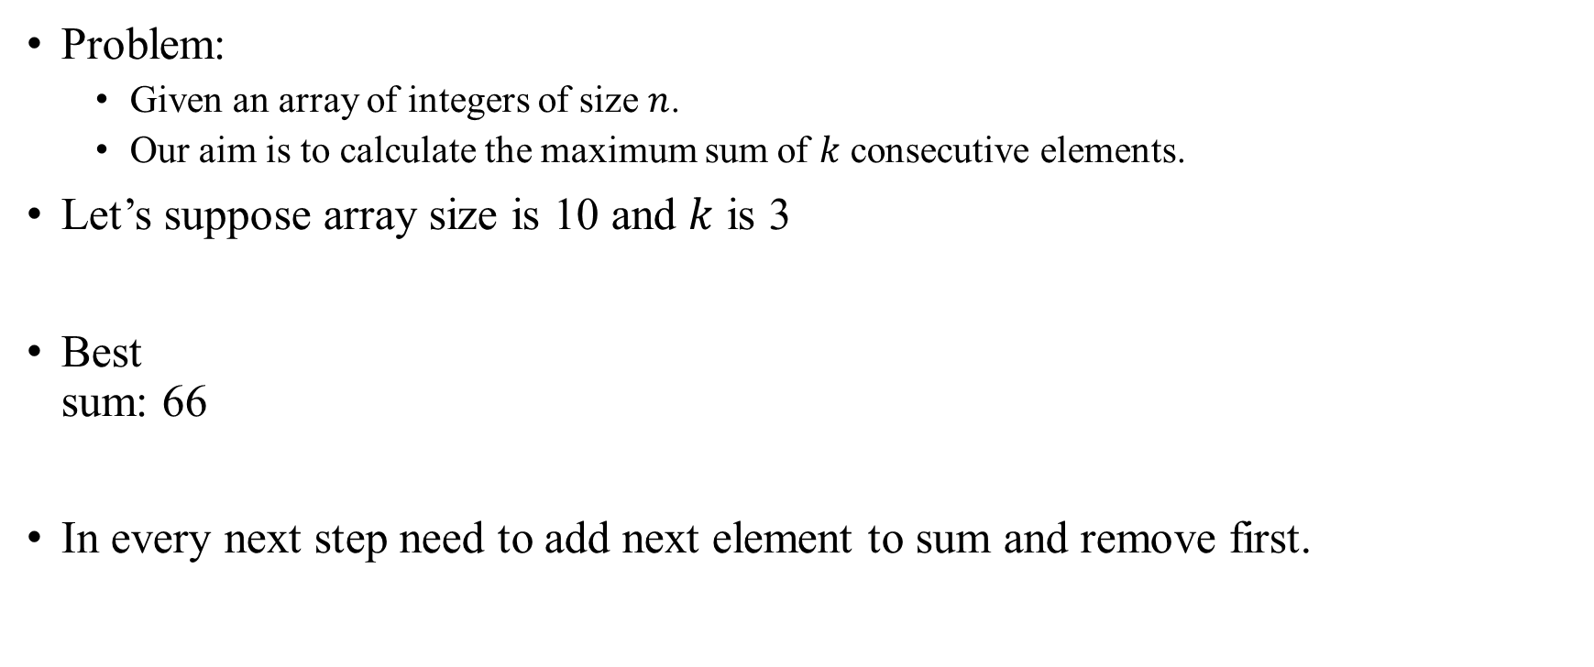
Sliding window technique Problem visualization
Problem:
Given an array of integers of size $n$.
Our aim is to calculate the maximum sum of $k$ consecutive elements.
Let’s suppose array size is 10 and $k$ is 3
Best sum: 66
In every next step need to add next element to sum and remove first.
10 | 8 | 6 | 13 | 11 | 15 | 1 | 50 | 2 | 10

Slide 14
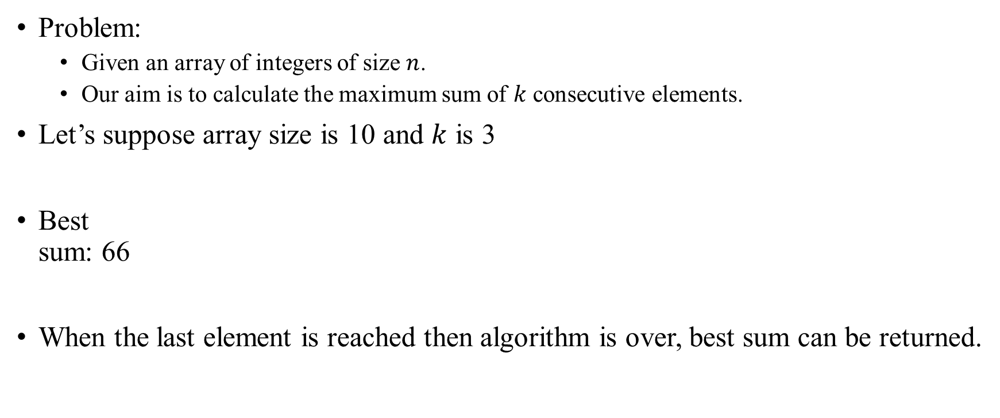
Sliding window technique Problem visualization
Problem:
Given an array of integers of size $n$.
Our aim is to calculate the maximum sum of $k$ consecutive elements.
Let’s suppose array size is 10 and $k$ is 3
Best sum: 66
When the last element is reached then algorithm is over, best sum can be returned.
10 | 8 | 6 | 13 | 11 | 15 | 1 | 50 | 2 | 10

